Slide 1
GNA UNIVERSITY
LAW AND ENGINEERING
SUBMITTED TO:- SUBMITTED BY:-
MR.MANDEEP SINGH HEER NAGESHWAR PANDEY
B.TECH CSE
GU-2019-3130

Slide 2
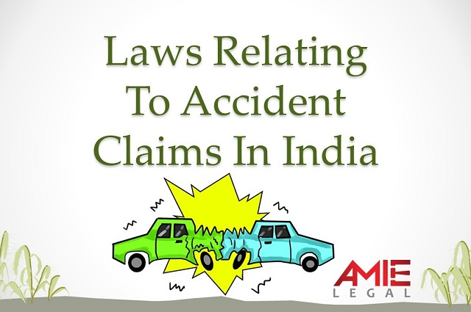
LAWS RELATED TO ACCIDENT CASES

Slide 3
MOTOR VEHICLES ACT,1988
Indian Motor Vehicles Acts, from 1914-2016
Indian Motor Vehicles (Amendment) bill ,2017
Indian Motor Vehicles (Amendment) Act, 2019
Implementation of the Amended Law

Slide 4
MOTOR VEHICLE ACT
The Motor Vehicles Act is an Act of the Parliament of India which regulates all aspects of road transport vehicles.

Slide 5
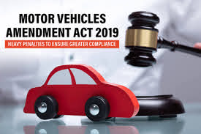
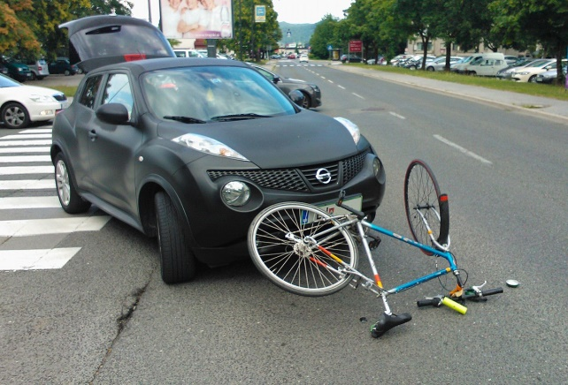

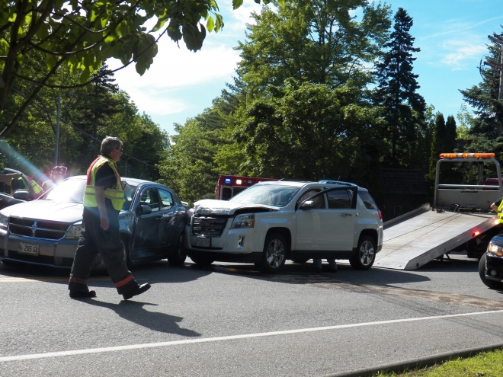

Slide 6
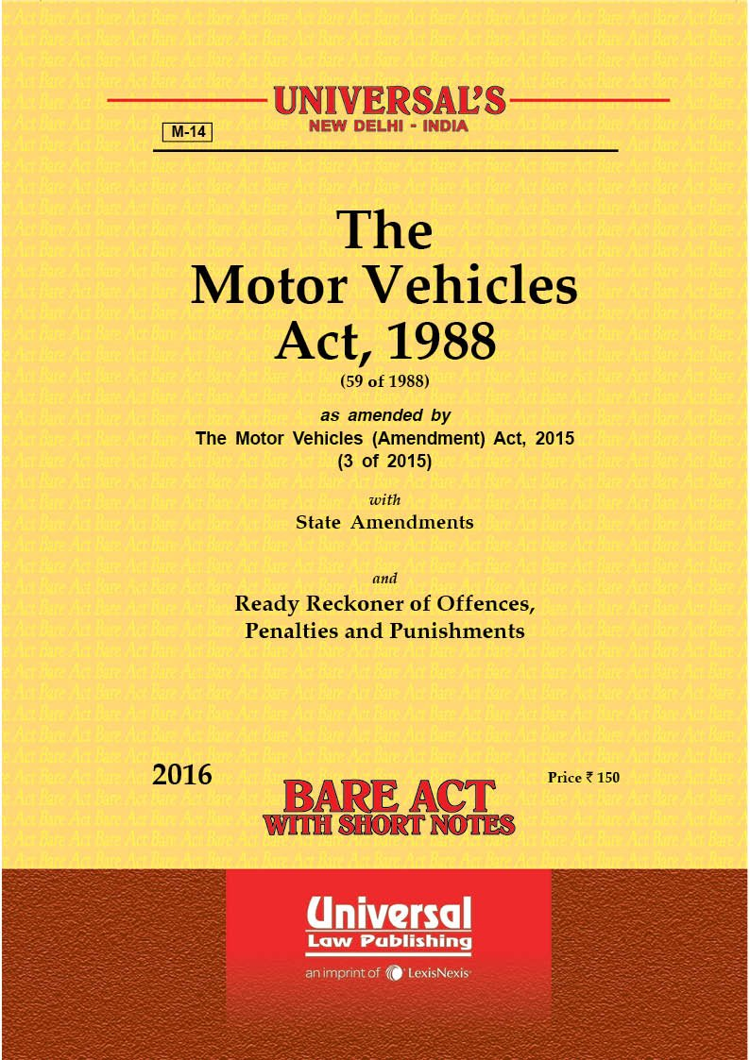

Slide 7
Salient features of Motor Vehicles (Amendment) Act, 2019
Motor Vehicle Accident Fund
Electronic monitoring and enforcement of road safety
Changes in Driver's license testing
National Register of DL
Use of Aadhar
Online Learning Licence
Offences and Penalties
Punishment for offences relating to construction, maintenance, sale and alteration of motor vehicles and components.

Slide 8
RECENT AMENDMENT
Some major changes have been made the Motor Vehicle Act, 1989 which will come in effect from October 1, 2020. According to the amendment, you can forego the baggage of physical documents and keep the soft copy of your driving licence and other documents while driving.

Slide 9
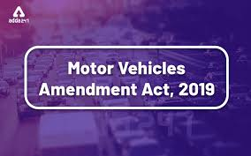
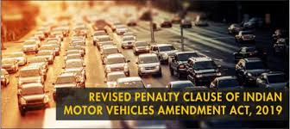
MOTOR VEHICLE AMENDMENT
ACT,2019

Slide 10
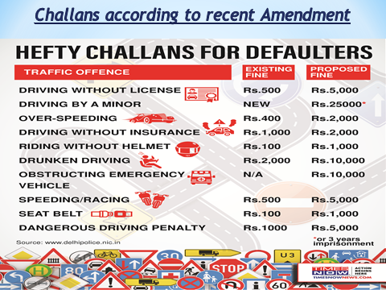

Slide 11
THE FATAL ACCIDENTS ACT,1976
The Fatal Accidents Act 1976 (c 30) is an Act of the Parliament Of United Kingdom, that allows relatives of people killed by the wrongdoing of others to recover damages.
The Fatal Accidents Act 1846 had allowed claims for damages by the relatives of deceased persons for the first time. The 1976 Act mordernised the process and repealed earlier legislation.

Slide 12
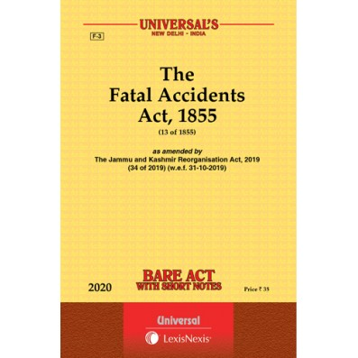

Slide 13
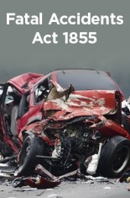
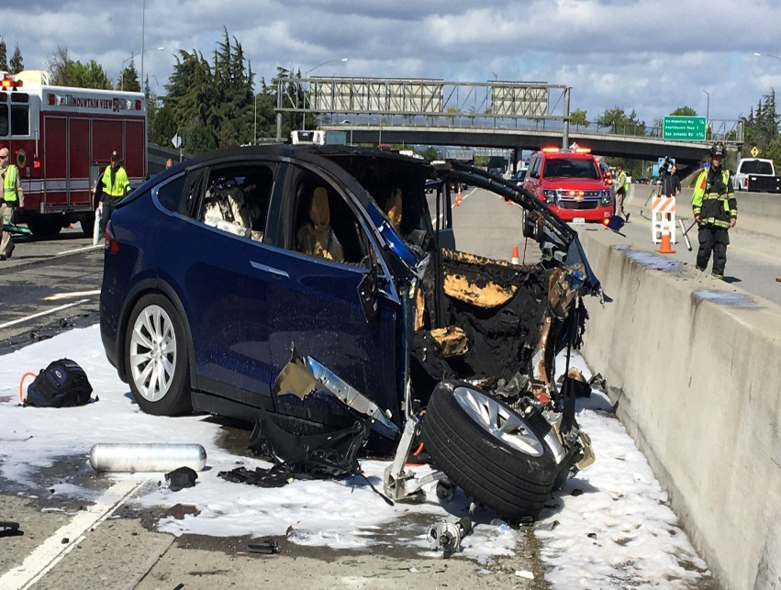
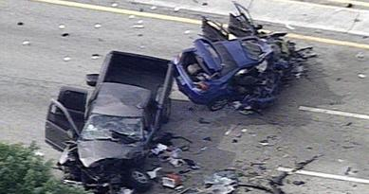


Slide 14
Features of FATAL ACCIDENTS ACT
Compensation awarded for loss of dependency, worked out by applying the principle of multiplier is a part of damages “proportioned to the loss resulting from the death”.
Section 1A of the Fatal Accidents Act, 1855 read with section 110B of the Motor Vehicles Act, 1939 (Now see Motor Vehicles Act, 1998), makes it obligatory on the tribunal to award “just compensation” which differs from case to case.
The maintainability of the claim for damages on account of the agony suffered by wife cannot be claimed by the plaintiff in a representative capacity. As husband he can claim damages either under the Fatal Accidents Act or under, the Motor Vehicles Act; M.L. Singhal v. Dr. Pradeep Mathur, AIR 1996 Del. 261.

Slide 15

THANK YOU

